Slide 1
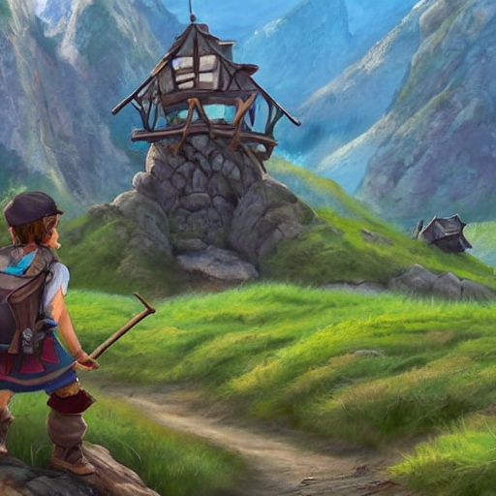
Introduction Mini Project

Slide 2
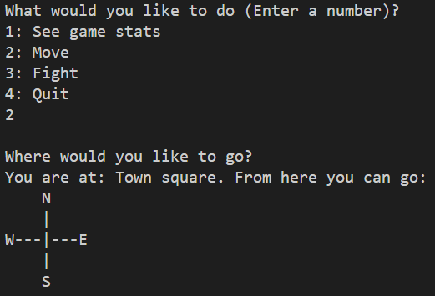
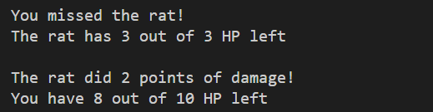
Simple RPG (Role Playing Game)

Slide 3
Goal
Hands-on experience with:
Scrum
C#

Slide 4
Deadline
Project lesson Week 3.2

Slide 5
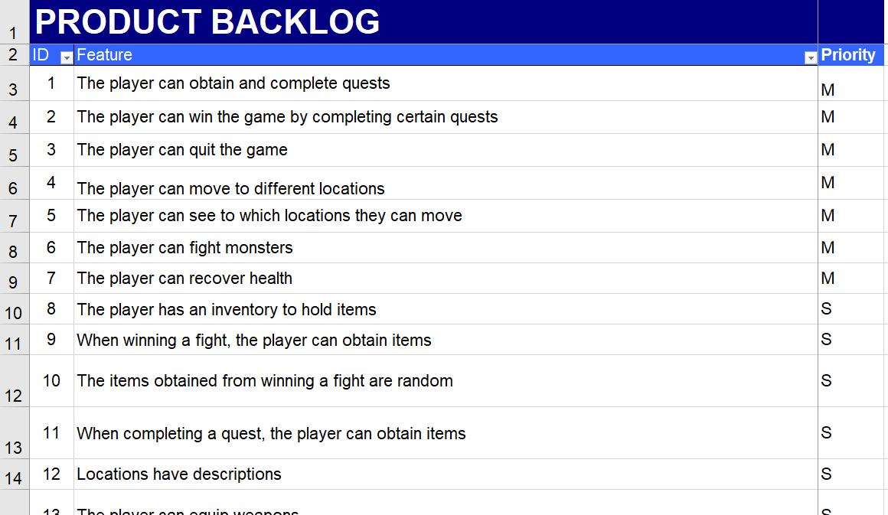
Product backlog (will be shared)

Slide 6
Product backlog
Project is designed to be large
You probably won’t complete it
This is fine!

Slide 7
Mini Project
Duration: 1,5 week
Given the backlog:
Select features
Divide amongst the team
Implement (+ merge, test & review)

Slide 8
Code base (will be shared)
World.cs is used to create:
Locations
Monsters
Weapons
Quests

Slide 9
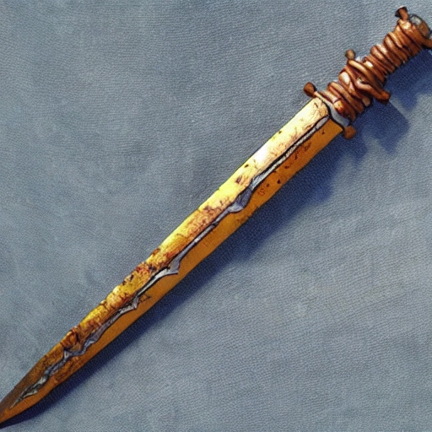
The Hero
You start off with a rusty sword
Serviceable, but perhaps you could find a better weapon?

Slide 10
The game
The people in your town are being terrorized by giant spiders. You decide to do what you can to help.
Objective: complete all quests
Map:
Map with locations:
|
|
--+---
|
P
A
VFTGBS
H

Slide 11
The game
Legend:
H: Your house (game start)
T: Town square
F: Farmer
V: Farmer’s field
A: Alchemist’s hut
P: Alchemist’s garden
G: Guard post
B: Bridge
S: Spider forest
P
A
VFTGBS
H

Slide 12

Quest: Clear the farmer’s field
P
A
VFTGBS
H
Given by Farmer (F)
Kill snakes in the farmer’s field (V)
Killing three snakes will complete the quest
“I can't w'rk mine own landeth with those pesky snakes slith'ring 'round! Shall thee holp me?”

Slide 13
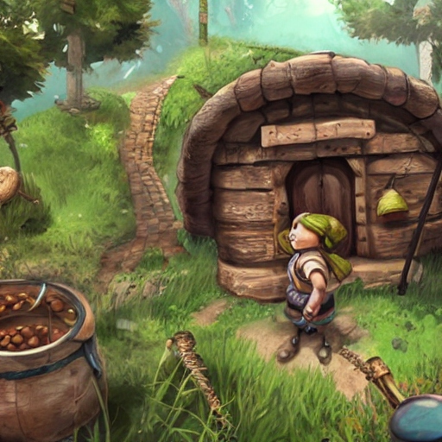
Quest: Clear the alchemist’s garden
P
A
VFTGBS
H
Given by Alchemist (A)
Kill rats in the alchemist’s garden (P)
Killing three rats will complete the quest
“Those rats art nibbling on mine own h'rbs! I couldst very much useth an adventur'r to taketh careth of those folk …”

Slide 14
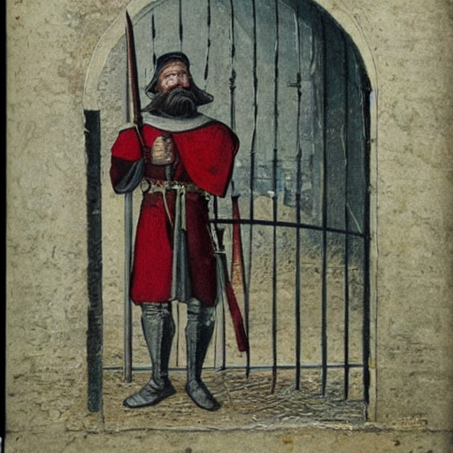
Guard’s post
P
A
VFTGBS
H
You need to have finished the other two quests before passing the guard
“Turn back at once, peasant! Unless thee hast proof of thy grit.”

Slide 15
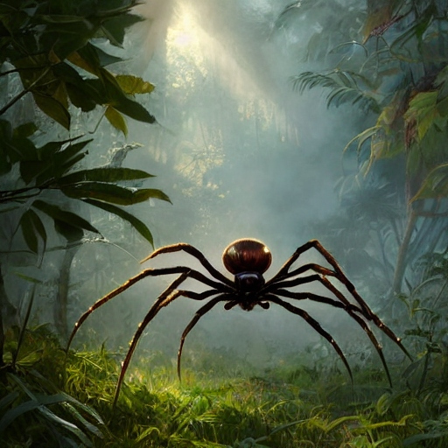
Quest: Collect spider silk
P
A
VFTGBS
H
Received when reaching the bridge (B)
Kill spiders in the spider forest (S)
The game is won when you have killed three spiders
“I shalt releaseth the town folks of their feareth!”

Slide 16
Demonstration
In Week 3.2, you will hand in the Mini Project
You will also give a demo

Slide 17
Constraints
Must be built in C# (.NET 7)
Must be console-based
GitHub must be used
Scrum must be used
VSCode/VS must be used
World.cs must be used as a code base
(Feel free to edit World.cs to your needs)
Must be built using OO

Slide 18
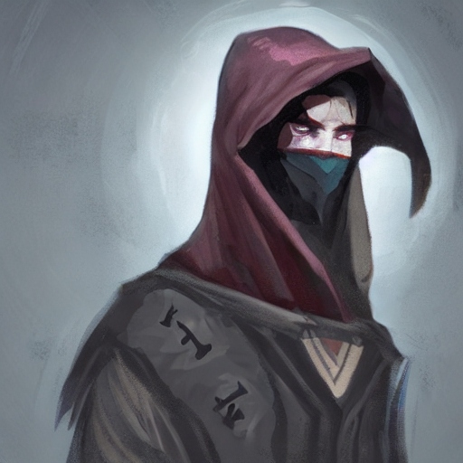
Questions?
The dungeon master shall provide thou with answers

Slide 19
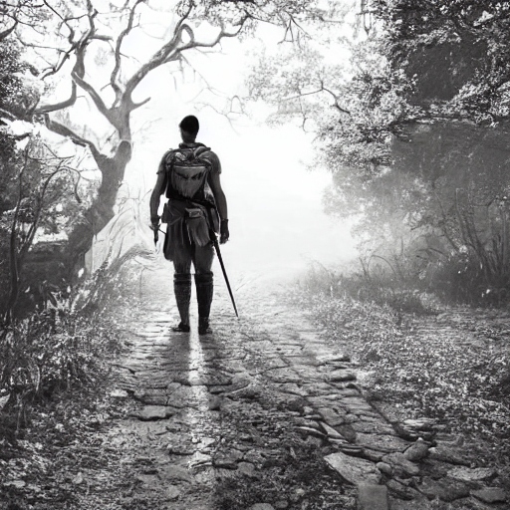
Embark on thy quest, adventur'r!
All illustrations created using deepai.org

